Slide 1
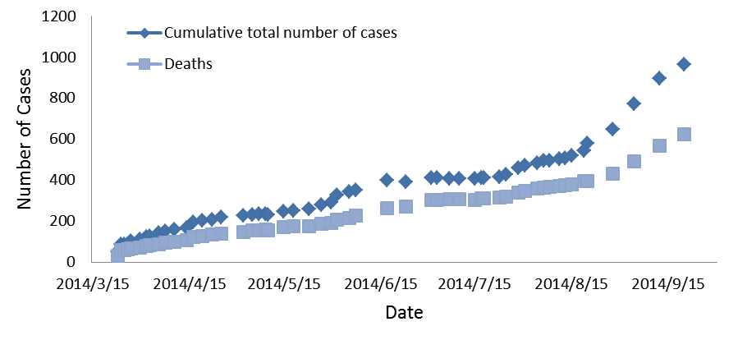
The cumulative total number of cases and deaths attributable to EVD in Guinea by WHO
2014/3/19-2014/9/20

Slide 2
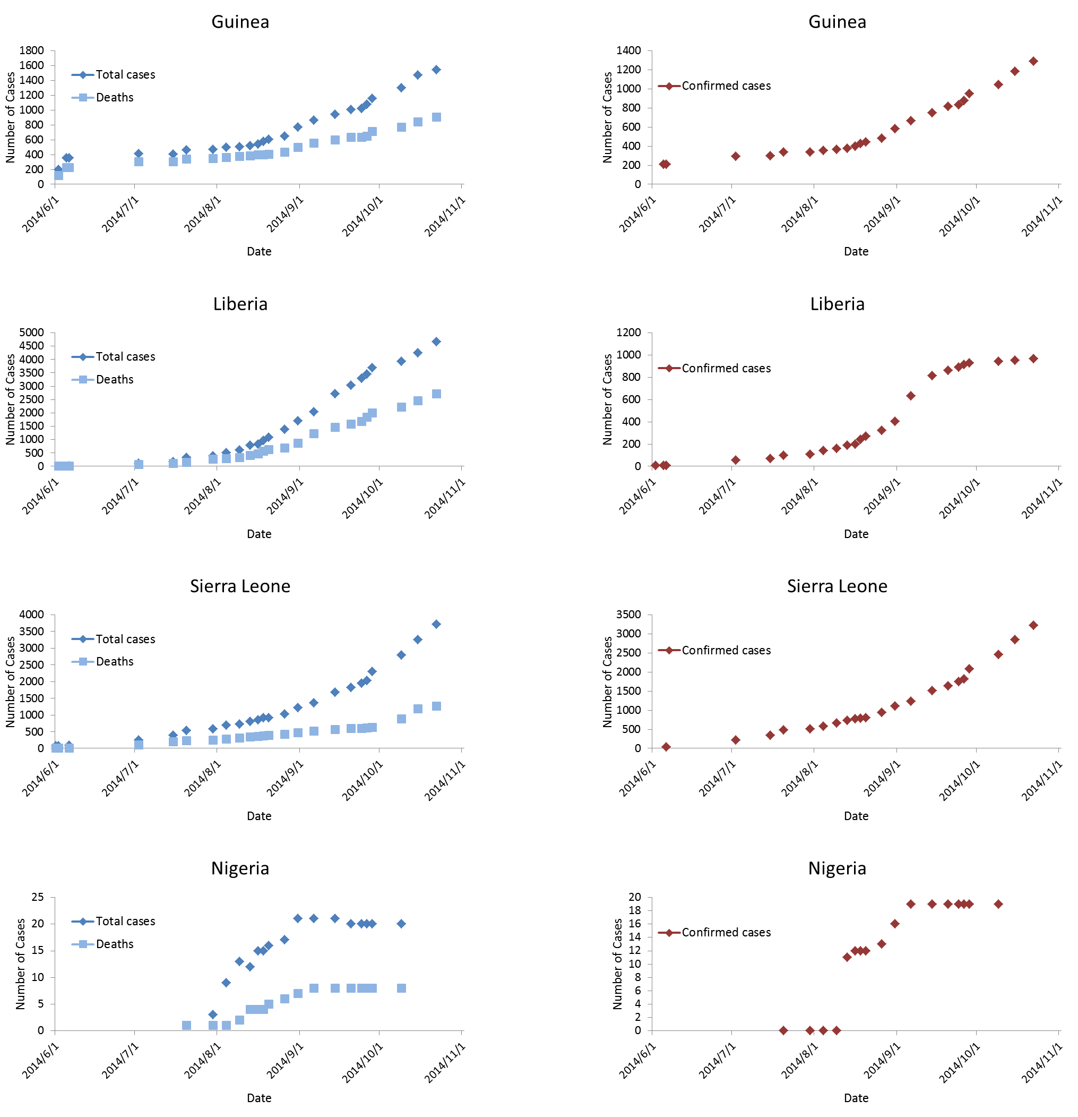
The cumulative total cases and deaths of EVD
by MOFA: 2014/6/1-2014/10/22
The cumulative total number of cases attributable to EVD
by MOFA : 2014/6/1-2014/10/22

